Slide 1
Reinforcement Learning
A Brief Introduction
Presenter：Ge Haizhou
2023.12.22

Slide 2
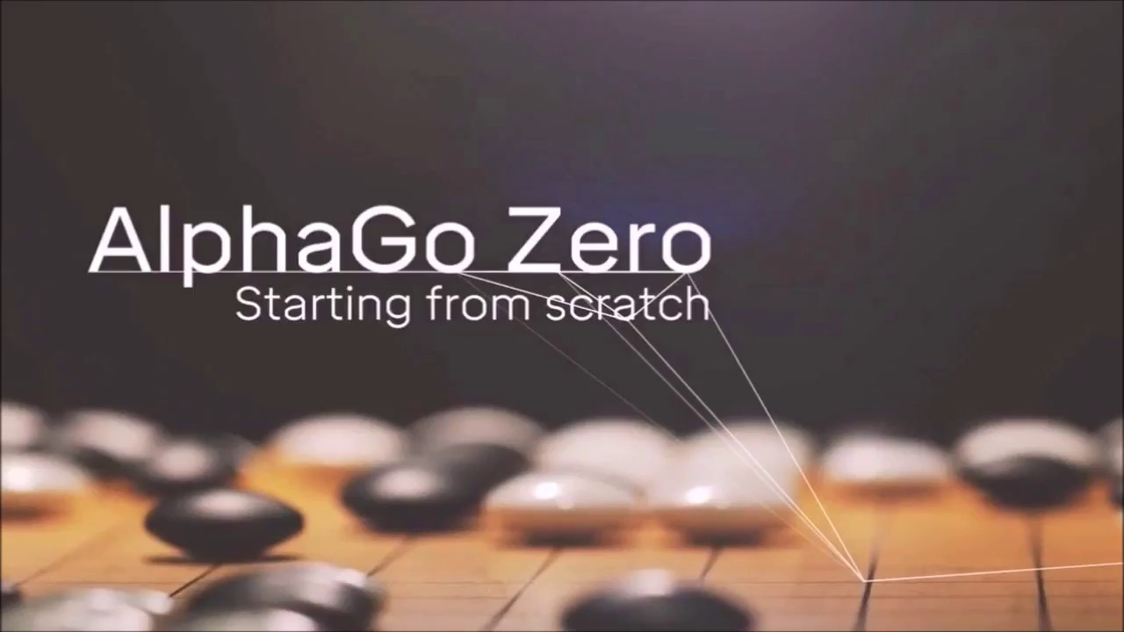
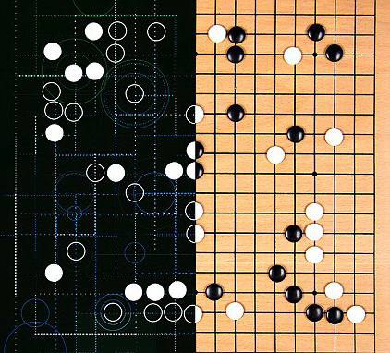
1. Computers can learn from scratch
How machines should learn?

Slide 3
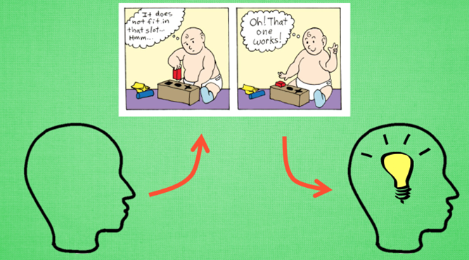
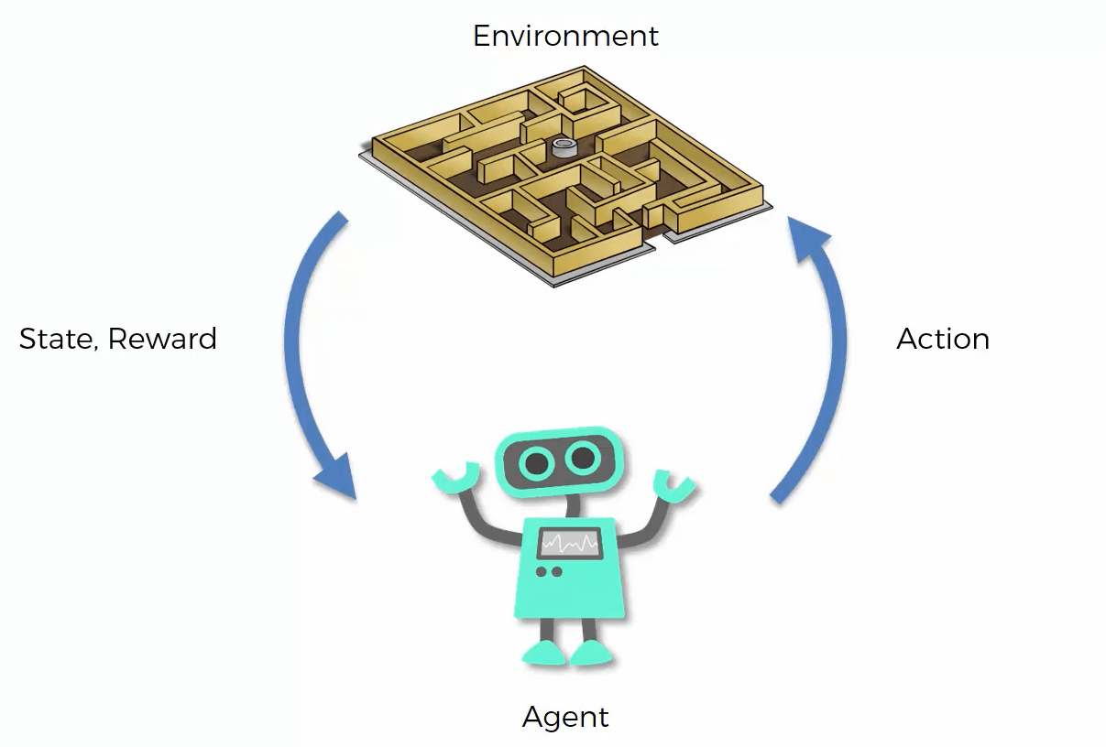
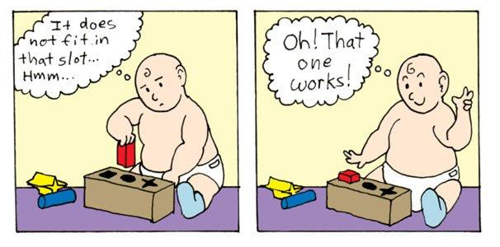
2. What is Reinforcement Learning
Learn by trial and error.

Slide 4
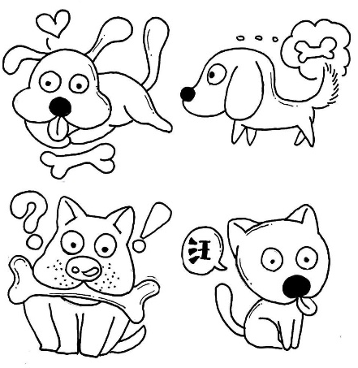
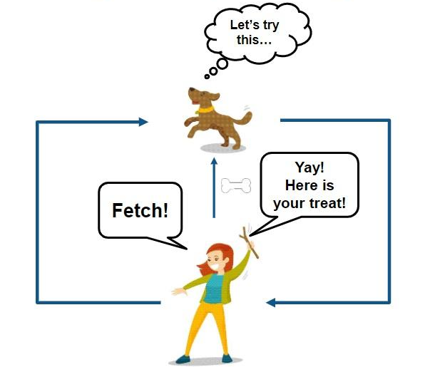
3. Analogies with pet training
Trick or treat?

Slide 5
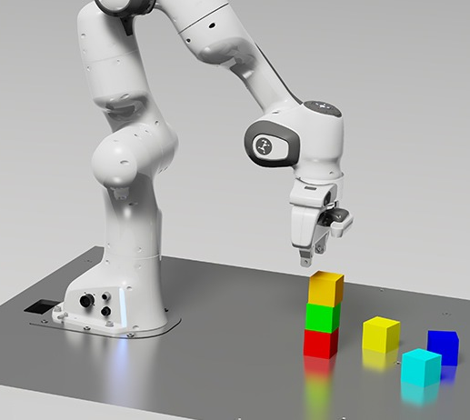
4. Conclusion
The way to Artificial General Intelligence.

Slide 6
谢谢大家!

